Slide 1

National Integrated Services Framework
The Foundation for Future e-Health Connectivity
Peter Connolly
HSE
December 2013

Slide 2
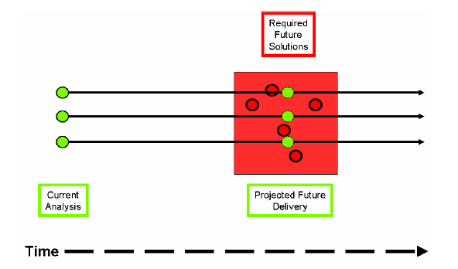
The Essence of Interoperability
Courtesy of NEHTA

Slide 3
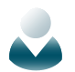











Deployment
Guidance
Documents
Primary
Public Health
Others
Procurement
Standards
Data Structure
Data Types
Business Case
Technical &
Information Architecture
Vendor Selection
Delivery
Maintenance
Delivery Platform
Stakeholders
Data Dictionary
Terminology Binding
Data Registry/
Repository
ICT Delivery
Distributed Applications
Procurement
Deployment

Slide 4
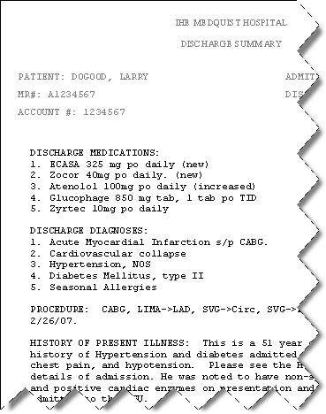
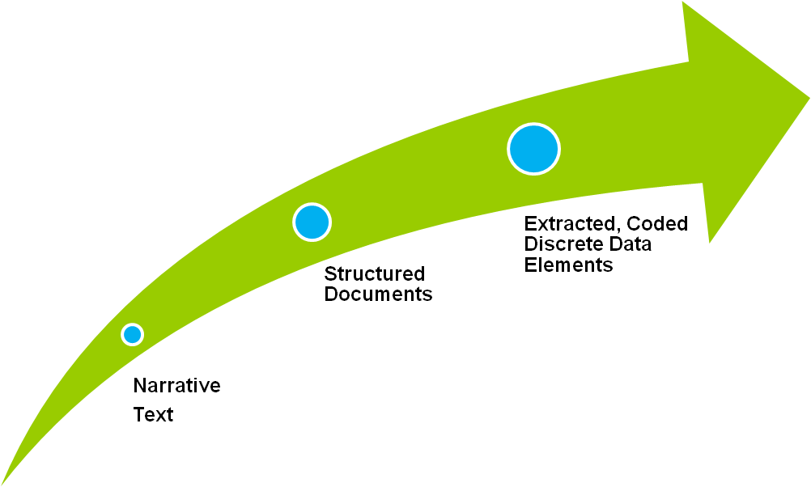
Proof-of-Concept (SAM ePSOS)
Disease, DF-00000
Metabolic Disease, D6-00000
SAM Repository
Disorder of carbohydrate metabolism, D6-50000
Disorder of glucose metabolism, D6-50100
Diabetes Mellitus, DB-61000
Neonatal, DB75110
Type 1, DB-61010
Carpenter Syndrome, DB-02324
Clinical Applications
Insulin dependant type IA, DB-61020
Value
Data Dictionary Portal
Integrate
Validate & Publish
Proof-of-Concept

Slide 5
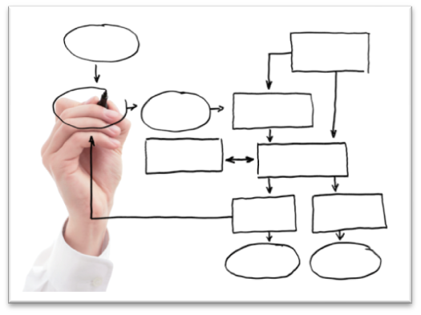
Tender Deliverables
Determination of the Information Model
Specification for the Data Dictionary
Terminology Assurance
Support Processes & Services

Slide 6
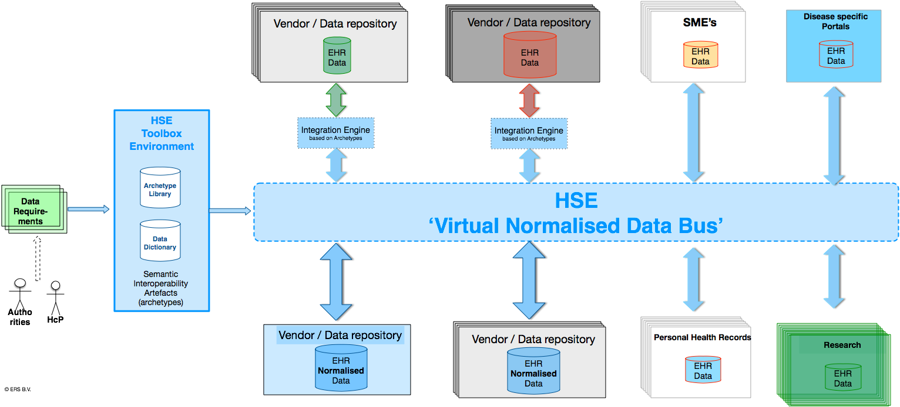
Information Architecture Reference Model (IA-RM)
MedDRA; HL7 E2B; ISO IDMP
WHO ATC/DDD;
WHO INN (International Nonproprietary Names)
LOINC (Lab) and ICPC2
Healthlink messaging - HL7v2, XML
ICD10 and Health One dictionary
PICNIC; loosely based on HL7v1 (not a standard)
Edifact (ebXML)
IPU codes/ATC/GMS -IPU product file
GS1
Snomed CT
Contsys
HISA
ISO 13606
HL7 -
Functional Model
IS0 21090

Slide 7
Information Architecture Reference Model (IA-RM)
MedDRA; HL7 E2B; ISO IDMP
WHO ATC/DDD;
WHO INN (International Nonproprietary Names)
LOINC (Lab) and ICPC2
Healthlink messaging - HL7v2, XML
ICD10 and Health One dictionary
PICNIC; loosely based on HL7v1 (not a standard)
Edifact (ebXML)
IPU codes/ATC/GMS -IPU product file
GS1
Snomed CT
Contsys
HISA
ISO 13606
HL7 -
Functional Model
IS0 21090
Standardised
& Common
Information
Architecture

Slide 8
Information Architecture Reference Model (IA-RM)
MedDRA; HL7 E2B; ISO IDMP
WHO ATC/DDD;
WHO INN (International Nonproprietary Names)
LOINC (Lab) and ICPC2
Healthlink messaging - HL7v2, XML
ICD10 and Health One dictionary
PICNIC; loosely based on HL7v1 (not a standard)
Edifact (ebXML)
IPU codes/ATC/GMS -IPU product file
System 1
System 2
System 3
System 4
GS1
Snomed CT
Contsys
HISA
ISO 13606
HL7 -
Functional Model
IS0 21090
Standardised
& Common
Information
Architecture
System 5
System 6
System 7
System 8

Slide 9
Information Architecture Reference Model (IA-RM)
MedDRA; HL7 E2B; ISO IDMP
WHO ATC/DDD;
WHO INN (International Nonproprietary Names)
LOINC (Lab) and ICPC2
Healthlink messaging - HL7v2, XML
ICD10 and Health One dictionary
PICNIC; loosely based on HL7v1 (not a standard)
Edifact (ebXML)
IPU codes/ATC/GMS -IPU product file
System 1
System 2
System 3
System 4
GS1
Snomed CT
Contsys
HISA
ISO 13606
HL7 -
Functional Model
IS0 21090
Standardised
& Common
Information
Architecture
System 5
System 6
System 7
System 8

Slide 10
Information Architecture Reference Model Components
Structure
IA-RM
Templates
Common Record Architecture
Standardised
& Common
Information
Architecture
Words
Meanings
Archetypes
Terminology Concepts
Data Dictionary
Terminology Descriptions
Governance
Quality Assurance
Change Management

Slide 11
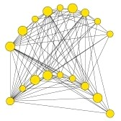
Example Case – Child Health System Information Challenge
NICIS will be used to capture all immunisation events including national childhood immunisation programmes (including schools), outbreaks, campaigns, late entrants, adult vaccinations and pandemic response. In addition the system should allow for the recording of client information relating to neonatal and metabolic screening, breast feeding and developmentals.
The NICIS system will require data sharing with;
The Maternal and Newborn Clinical Management System (MN-CMS) (and prior to that being in place to the Dublin Maternity Hospitals
The National Client Identity Services
Health Service Provider
GP practice management systems
National Cold Chain Delivery System
Primary Care Reimbursement Services (PCRS)
National Cancer Service
The National Childcare System
Department of Social and Family Affairs
The National Newborn Bloodspot Screening
Laboratory (NNBSL),
Universal Neonatal Hearing Screening (UNHS)

Slide 12
Directive 2011/24/EU
2.1. Directive on patients’ rights in cross-border healthcare
  Directive 2011/24/EU provides rules for facilitating access to safe and high-quality crossborder healthcare and promotes cooperation on healthcare between Member States taking full account of national competencies in organizing and delivering healthcare.
Article 14 states:
  “1. The Union shall support and facilitate cooperation and the exchange of information among Member States working within a voluntary network connecting national authorities responsible for eHealth designated by the Member States.

Slide 13
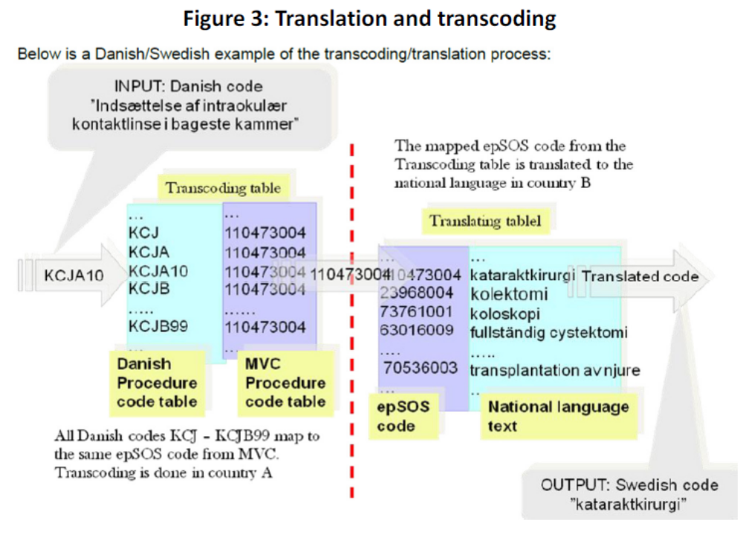
Directive 2011/24/EU

Slide 14

Benefits
Technical Architecture
Because of the HSE Tooling Environment and re-usable components an ecosystem can emerge that encompasses:
Personal Health Records
Disease portals
Registries
eHealth Apps
Research
Reporting
Notes:
Since data is standardised and structured more will be enabled and become possible.
An ECOSYSTEM can arise because small companies can start to provide new innovative services, or
clinical research can be integrated into existing systems, or
Healthcare providers can start to submit structured and standardised data to authorities.
As can be seen in this slide.

Slide 15

Approach
Workshops
Interviews
Questionnaires
Feedback Sessions
Demonstrations

Slide 16
Timetable
Requirement | Due Date
Determination of the Information Model | Fri 31/01/14
Data Dictionary | Fri 31/01/14
Terminology Assurance | Fri 28/03/14
Support Processes & Services | Fri 28/03/14

Slide 17
Questions…?

